Slide 1
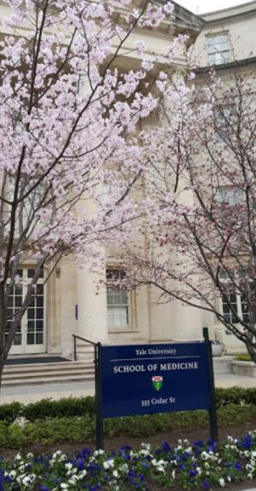
Transitioning Cellular and Molecular Observations through Computational Models: Impact of Paracrine Signaling on Self-Renewal and Differentiation of Stem Cells ANS/HPS 208 Conference Applicability of Radiation-Response Models to Low-Dose Protection Standards Guidelines September 30 – October 3, 2018
Nicholas Dainiak, MD, FACP
Department of Therapeutic Radiology
Yale University School of Medicine
New Haven, CT
Ronald Goans, MD, PhD, MPH
MJW Corporation
Amherst, NY

Slide 2
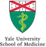
Objectives
Review the spatial distribution of hematopoietic stem cell (HSC) niches in the normal bone marrow, and the role of paracrine signaling in maintaining homeostasis of the hematopoietic system.
Understand the importance of microvesicles (MV) in trafficking HSC differentiation signals and bystander signals, including radiation-induced death signals (FasL; TNFSF6).
Apply a mathematical model to describe MV diffusion and calculate diffusion length for MV to results obtained in a full-thickness human skin model exposed to α-particles, using the Columbia University charged-particle microbeam (Belyakov OV, et al. Proc Natl Acad Sci USA 1982; 102:14203-14208).

Slide 3
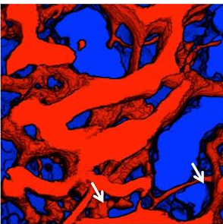
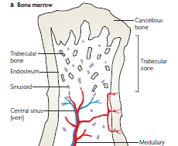
Bone Marrow Anatomy
350 µm
350 µm
Arrows: arterioles that empty into larger sinusoids
Kiel MJ and Morrison SJ, Nature Rev Immunol 2008; 8: 290
Morrison SJ and Scadden DT, Nature 2014; 505: 327

Slide 4
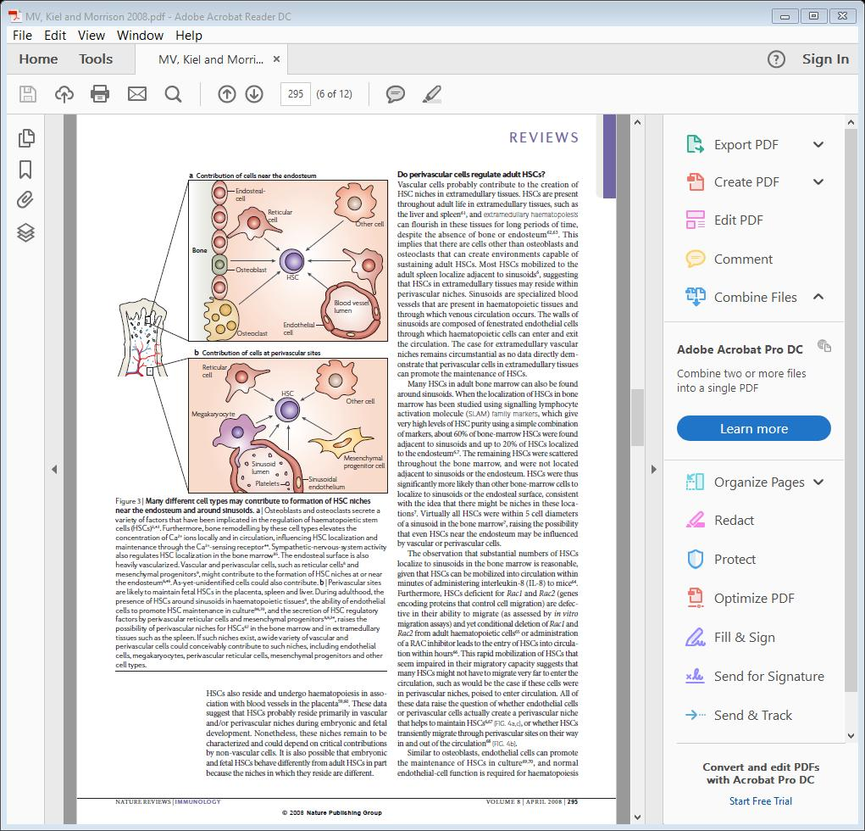
Spatially Distinct Marrow Niches with Different Functions
T-cells
B-cells
NK cells
Macs
Is there one HSC niche that is multifunctional or multiple HSC niches, each with a separate function?
HSCs release MV that carry signals, suggesting that bidirectional communication occurs via MV.
Endosteal Niche
Perivascular Niche
Kiel MJ and Morrison SJ, Nature Rev Immunol 2008; 8: 290

Slide 5
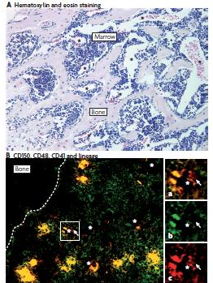
Projected Distances Needed to Traverse a Niche
Venous sinusoid
HSCs are CD150+
(red), CD48-, CD41-
Fewer than 20% of HSCs are within 10 µm of the endosteum. In some cases, a signal must travel > 100 µm to reach a HSC target.
Kiel MJ and Morrison SJ, Nature Rev Immunol 2008; 8: 290

Slide 6
Intercellular Signaling
Exocytosis (hormones, cytokines, neural transmitters)
Proteolytic cleavage of surface molecules (EGFR)
Juxtacrine signaling at plasma membrane (pro-TGFβ, Boss-sevenless, PAF)
Gap junctions (ROS, DDR mediators, ions, cAMP)
Exfoliation (growth/death factors, MHC-I,-II, FcR, TfR)
Some signals may be transmitted by more than one mechanism: CSF, SCF, IL-1, Flt-3 Ligand, TNFα, Fas and FasL

Slide 7
Intercellular Signaling
Exocytosis (hormones, cytokines, neural transmitters)
Proteolytic cleavage of surface molecules (EGFR)
Juxtacrine signaling at plasma membrane (pro-TGFβ, Boss-sevenless, PAF)
Gap junctions (ROS, DDR mediators, ions, cAMP)
Exfoliation (growth/death factors, MHC-I,-II, FcR, TfR)
Some signals may be transmitted by more than one mechanism: CSF, SCF, IL-1, Flt-3 Ligand, TNFα, Fas and FasL

Slide 8
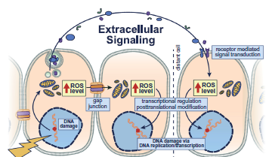
Model of Radiation-Induced Bystander Effects (RIBE)
Klammer H et al. Cancer Lett 2015; 356: 58

Slide 9
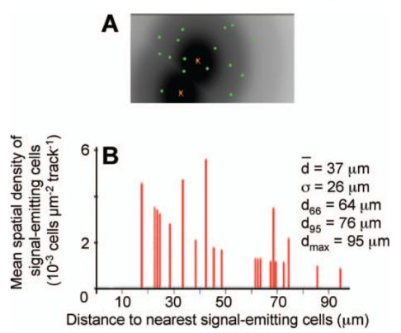
Propagation Distance of Gap Junction Communication
Green: p21^{Waf1} induction
Red x: signal-emitting cells eliminated from analysis
The stress-responsive protein p21^{Waf1} was used to assess propagation distance within a 100-µm radius around the intranuclear α-particle impact point in confluent human fibroblast cultures. Mean distance ranged from 20 – 40 µm.
Gaillard S et al. Radiat Res 2009; 171: 513

Slide 10
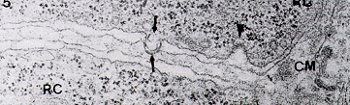
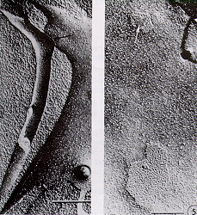
Proximal Intercellular Associations in Hematopoiesis
RC: red cell precursors; CM central macrophage
Tavassoli and Shaklai. (1979). Brit J Haematol 43:235
Bar - 0.5 m (500 nm)
Porvaznik and MacVittie, J. (1999). Cell Biol 82:555

Slide 11
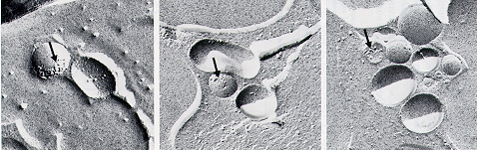
LCM Pellets Contain PM-Derived SVs
Freeze Fracture Electron Micrographs
Arrows: pits thought to represent integral membrane proteins
Mean size of 0.25 µm, range of 0.1-0.4 µm
Dainiak N. and Cohen CM (1982) Blood 60:583

Slide 12
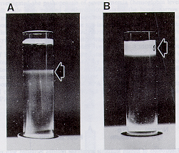
Vesicles Shed from Lymphocytes Spun to Equilibrium on Dextran Gradients
CM pellets were layered on dextran T70 in isotonic saline (A) or 0.3mM Na phosphate (B).
Dainiak N and Cohen CM. (1985). Ann NY Acad Sci. 459: 129
Notes:
Slide showing sucrose gradients with vesicles spun to equilibrium at different tonicities: Reference is Dainiak N and Cohen CM, Ann NY Acad Sci (1985) 459: 129-142.
Replace the images I gave you with a new one?
Would also add Fig 6 of the same article to this slide. Fig 6 shows IF and BPA for the gradient fractions in "B" (the right hand Fig 5 photograph showing the gradient prepared in 0.3 mM Na phosphate). It should be titled: "IF and BPA Assays of Dextran Gradient of Washed Pellets Resuspended in 0.3 mM Na Phosphate"

Slide 13
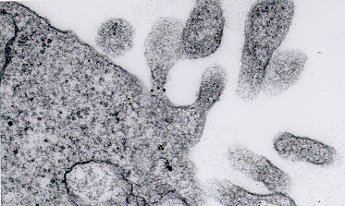
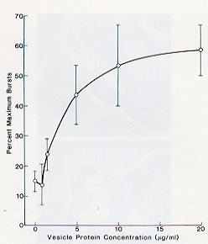
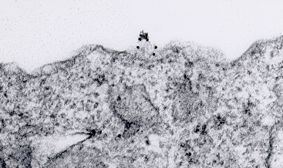
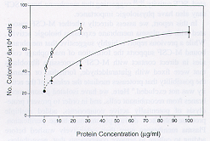
MV Express Growth Factors
Lymphocyte-derived BPA
Tip of Protrusion
Shed Vesicle (SV)
Base of Protrusion
COS-1 cells: M-CSF
Dainiak N and Cohen CM,
Blood 1982; 60: 583
SV
PM
Tuck D et al.
Blood 1994:
84: 2182

Slide 14
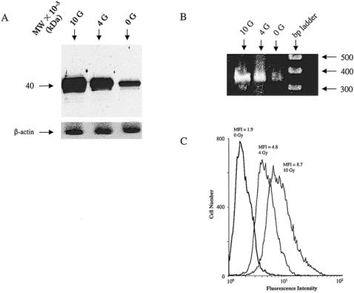
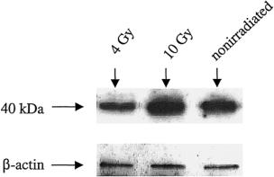
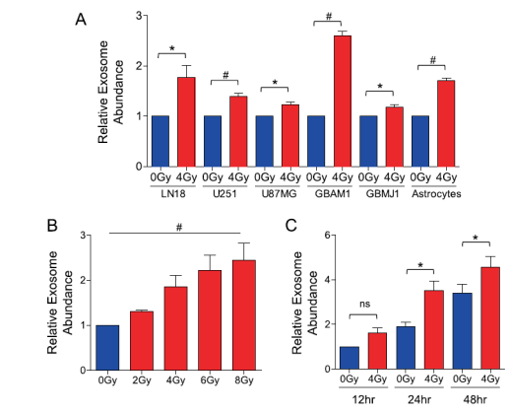
IR Induces Fas (TNFRSF6) Expression on MV Surface of SW620 Cells
Vesicles
SV released into serum-free medium were isolated, exposed to 0, 4 or 10 Gy, solubilized, resolved on SDS-PAGE and reacted with anti-TNFSF6 ab.
A: Western blots: PMs were isolated from control and irradiated SW620 cells, solubilized and analyzed
B: RT-PCR
Arscott WT et al.
Transl Oncol 2013;
6: 638
C: Flow Cytometry
Albanese J and Dainiak N Radiat Res 2000; 153:49

Slide 15
Comparison of Microvesicles (MV)
Characteristic | Shed Vesicles | Exosomes
Site of Origin | PM | Multivesicular Bodies (MVBs)
Mechanism of Release | PM Budding | Exocytosis of MVBs
Size (nm) | 100 - 1, 000 | 40 - 100
Density in Sucrose (r) | 1.02 - 1.03 (lymphocytes) | 1.10 - 1.20
Annexin V (PS) | Abundant | Minimal
Tetraspanins (CD63) | No | Yes
Tumor Susceptibility Gene Protein (TSG-101) | No | Yes
Some Other Proteins | GFs, death factors, metalloproteins, integrins, immune molecules, cytoskeletal proteins | GF receptors, PM fusion proteins, adaptor proteins, lipid rafts, HSPs, immune molecules, cytoskeletal proteins
Albanese J and Dainiak N Exp Hematol 2003; 31:455

Slide 16
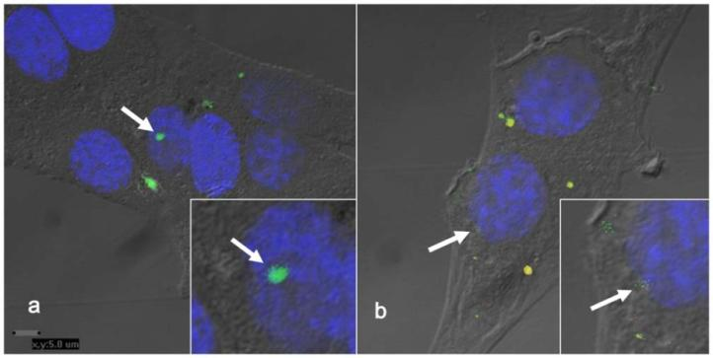
Horizontal Transfer of DNA and RNA via MV
Transfer to fibroblasts of DNA (green) to nuclei and RNA (yellow) to cytoplasm by MV isolated from cardiac myocytes
Waldenstrom et al. PLoS ONE 2012; 7: e34653

Slide 17
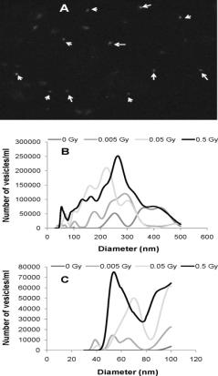
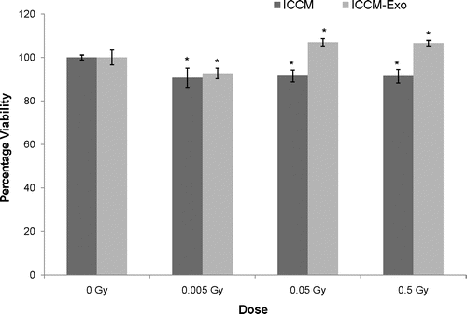
MV Mediate the Bystander Effect
MV Characterization
Requirement of MV for Bystander Effect
ICCM: Irradiated cell-conditioned medium prepared in DMEM with 10% Serum.
ICCM-EXO: medium supernatants after removal of MV by 100,000 x g, 1 hr.
MV were visualized by scanning EM in STEM mode (top), and their size distribution was assessed with the Nanosight LM10 system (B, C). MV were positive for the tumor susceptibility gene (TSG-101) protein marker for exosomes.
Jella KK et al. (2014) Radiat Res 181:138

Slide 18
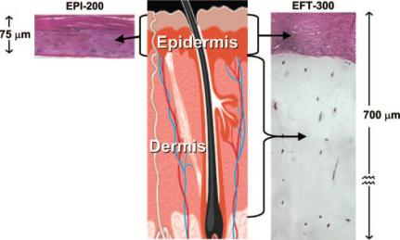
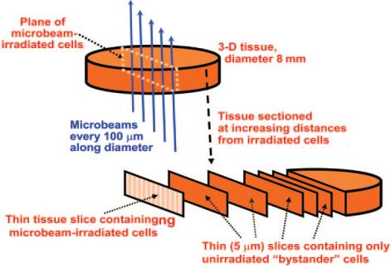
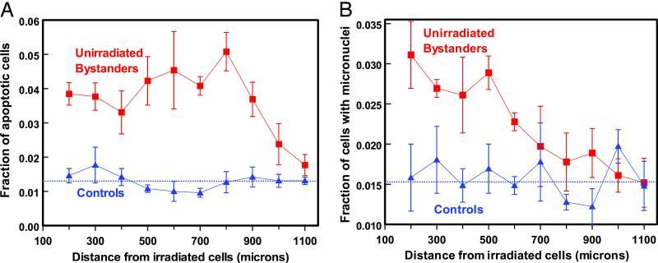
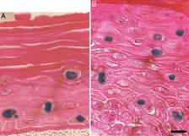
α-Particle Damage to Unirradiated Keratinocytes/Fibroblasts
Protocol
Skin
Model
Apoptotic Cells
Columbia University charged-particle microbeam:
7.2-MeV α-particles
scatter < 1 µm
range 60 µm
stopping power 80 keV/µm
Belyakov OV et al, PNAS (2005) 102:14203

Slide 19
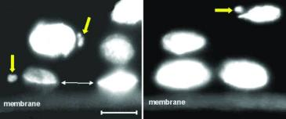
Analysis of MN Data
MN and broken neoplasmic bridge
SigmaPlot v. 11.0 (Systat Software, Inc., San Jose, CA 95131): curve-fitting software

Slide 20
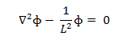
Model to Determine MV Diffusion Length
Assumptions:
1. MN number correlates with radiation dose
2. Average MV size is 0.25 µm
3. MV diffuse in culture medium with a diffusion length
Diffusion equation in a 3-dimensional absorbing medium is described by:
Laplacian Operator MV Flux L = Diffusion Length

Slide 21
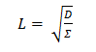
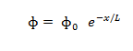
Calculation of Diffusion Length (L) by General Diffusion Equations
Diffusion Length is calculated by:
Columbia microbeam for MV transport is configured as 1-dimensional system where MN formation decreases as a function of χ. Solution reduces to:
MV Diffusion Coefficient
Macroscopic Cross-Section for MV absorption in a cell
MV Flux at χ=0 where flux is # cells interacting with MV ÷ cm² - sec

Slide 22
Determination of L for MV
Best exponential fit of MN formation by MV is linear for the fraction of cells with MN relative to the distance from irradiated cells:
r = 0.95
r² = 0.90
r = 0.95
r² = 0.90
Slope = 1 / L, and L = 1270 ± 160 µm
Conclusions: The diffusion length of 1.27 ± 1.6 mm for MV is sufficient to transfer signals throughout HSC niches in the bone marrow and beyond. Modeling IR effects can be used to enhance our understanding of normal biophysical processes.

Slide 23
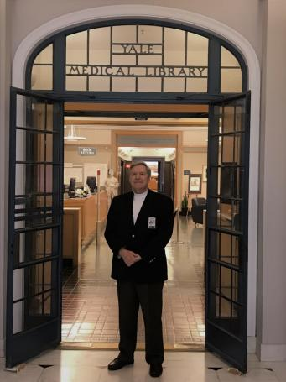
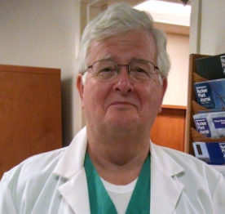
Thank You!
Nicholas Dainiak, MD, FACP
Clinical Professor
Director, CT Biodosimetry Laboratory at Yale
Department of Therapeutic Radiology
Yale University School of Medicine
PO Box 08040
333 Cedar Street
New Haven, CT 06520
NickDainMD@aol.com
Nicholas.Dainiak@Yale.edu
Ronald Goans, MD, PhD, MPH
MJW Corporation, Inc
15 Hazelwood Drive
Amherst, NY 14228
Ronald.Goans@comcast.net
www.mjwcorp.com

